Slide 1
Tuple Spaces
COMP 30240/41400: Multi-Agent Systems
Lecturer: Rem Collier
Email: rem.collier@ucd.ie

Slide 2
Tuple Spaces
A tuple is an immutable ordered list of 1 or more values.
<5>
<“Lecturer”, “Rem”>
<“Rem”, “age”, 48>
A tuple space is a shared memory consisting of multiple tuples that may be interacted with by one or more processes (agents).
They may be stand alone or distributed.
They are designed for concurrent programming
They expose a simple, Read, Write, Delete API

Slide 3
Tuple Space: Operations
Creating (Out Operation): Out(“Rem”, 48)
Adds a tuple to the tuple space
Tuples must be unqiue, but not individual parameters
Reading (Rd Operation): Rd(string:name, int:age)
Uses a template (parameters are variables)
Matches the template to tuples and returns one matching tuple (non-deterministically)
Deleting (In Operation): In(string:name, int:age)
Same as reading, but removes the matched tuple

Slide 4

Example
Tuple Space
Agent B
Agent A

Slide 5
Example
Tuple Space
<“Rem”, 48>
Agent B
Out(<“Rem”, 48>)
Agent A

Slide 6
Example
Tuple Space
<“Rem”, 48>
Rd(<string:x, int:y>)
Agent A
Agent B

Slide 7
Example
Tuple Space
<“Rem”, 48>
{x/”Rem”, y/48}
Agent A
Agent B

Slide 8
Example
Tuple Space
<“Rem”, 48>
Agent B
<“Joe”, 60>
Out(<“Joe”, 60>)
Agent A

Slide 9
Example
Tuple Space
<“Rem”, 48>
<“Joe”, 60>
?
Rd(<string:x, int:y>)
Agent A
Agent B

Slide 10
Example
Tuple Space
<“Rem”, 48>
<“Joe”, 60>
{x/”Rem”, y/48}
Agent A
Agent B

Slide 11
Example
Tuple Space
<“Rem”, 48>
<“Joe”, 60>
?
In(<string:x, int:y>)
Agent A
Agent B

Slide 12
Example
Tuple Space
<“Joe”, 60>
{x/”Rem”, y/48}
Agent A
Agent B

Slide 13
Example
Tuple Space
<“Joe”, 60>
In(<string:x, int:y>)
Agent A
Agent B

Slide 14
Example
Tuple Space
{x/”Joe”, y/60}
Agent A
Agent B

Slide 15
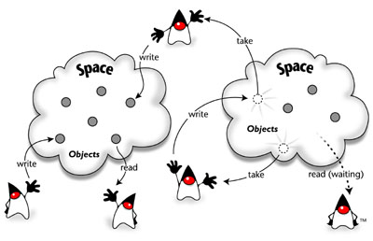
JavaSpaces
Originally implemented as part of Jini (now Apache River)
A failed distributed systems technology from the 1990s.
Includes a tuple-space implementation known as JavaSpaces.
Tuples = objects
Templates = classes
Home Page: https://river.apache.org/

Slide 16
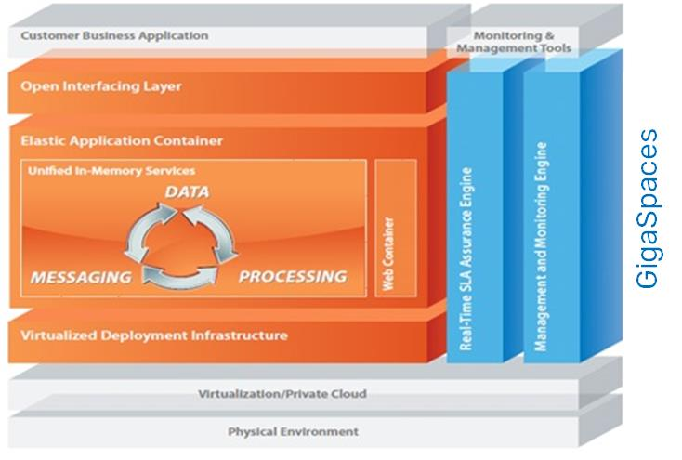
Gigaspaces https://www.gigaspaces.com/

